Slide 1
REVIEW API RESULTS

Slide 2
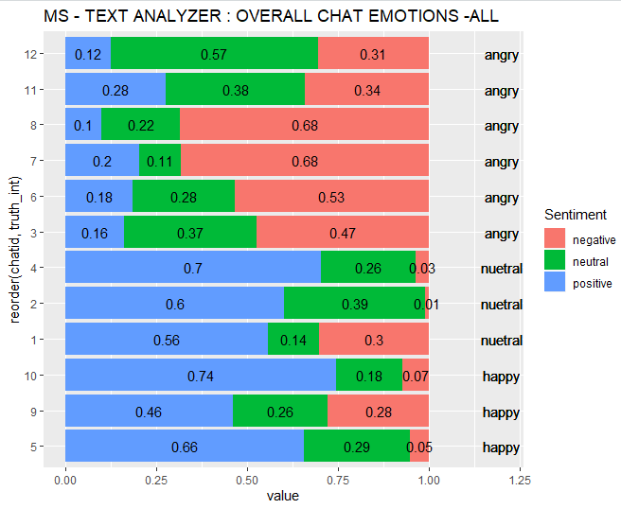
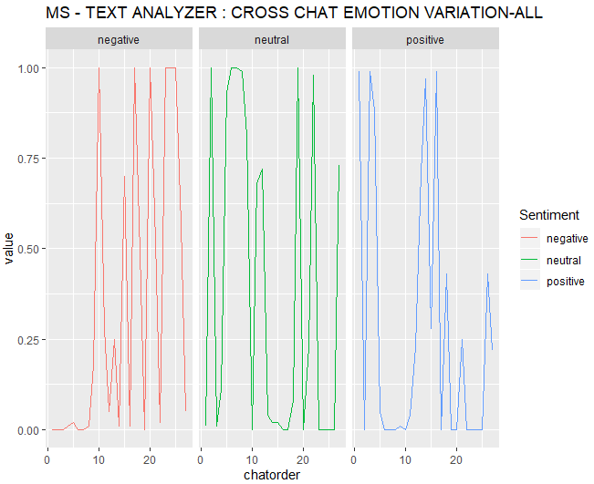
MS ANALYTICS

Slide 3
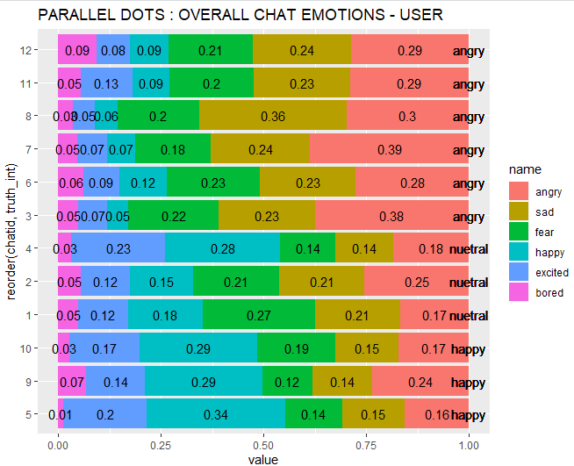
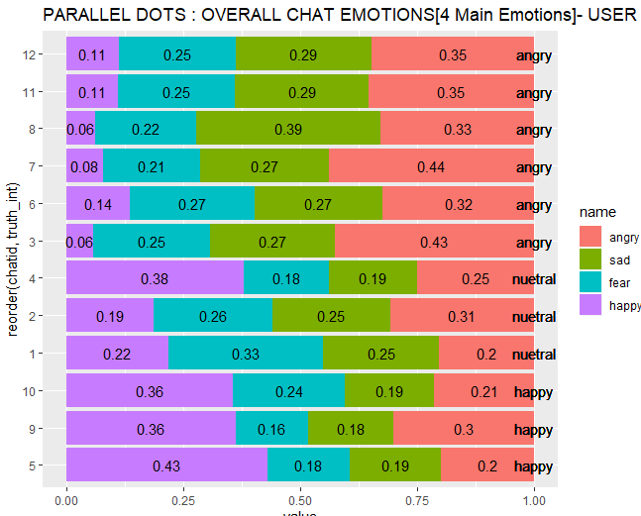
PARALLEL DOTS

Slide 4
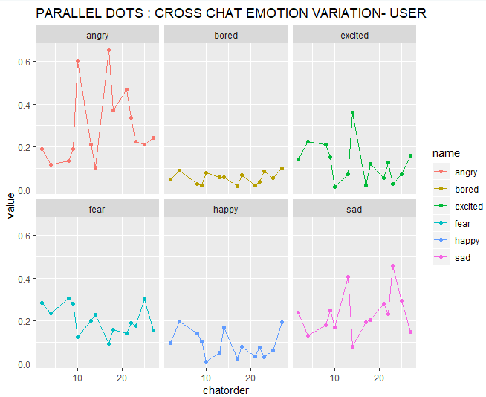

Slide 5
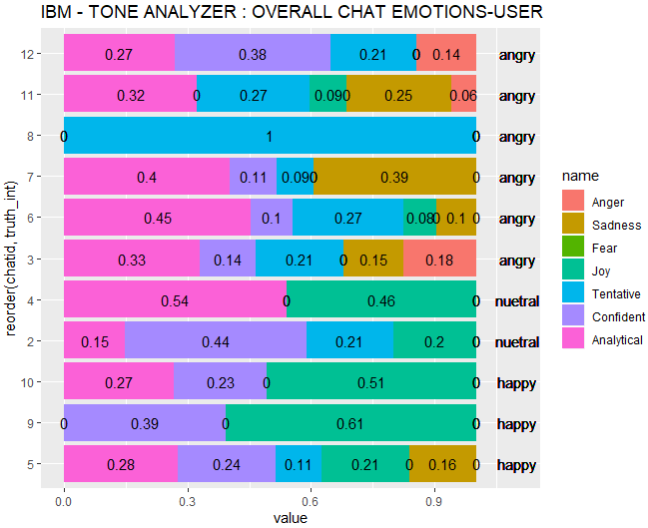
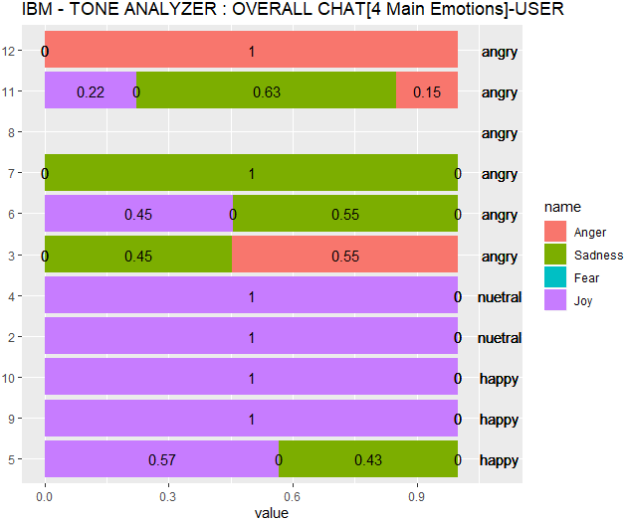
IBM TONE ANALYZER

Slide 6
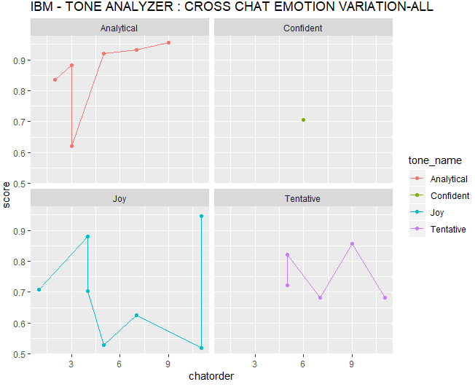

Slide 7
Compare Original API Results to BenchMark

Slide 8
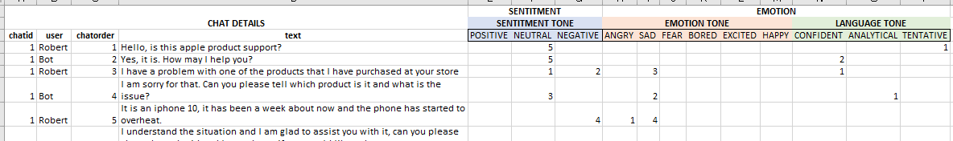
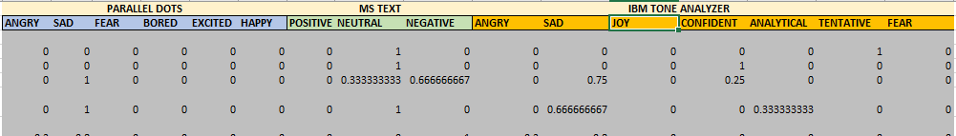
BenchMark
API

Slide 9
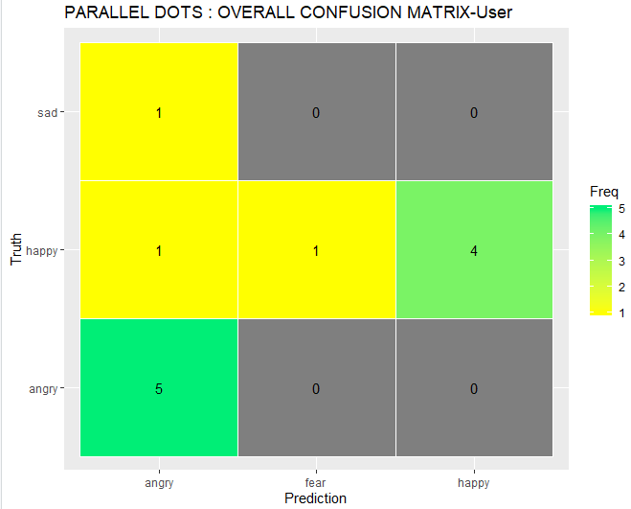
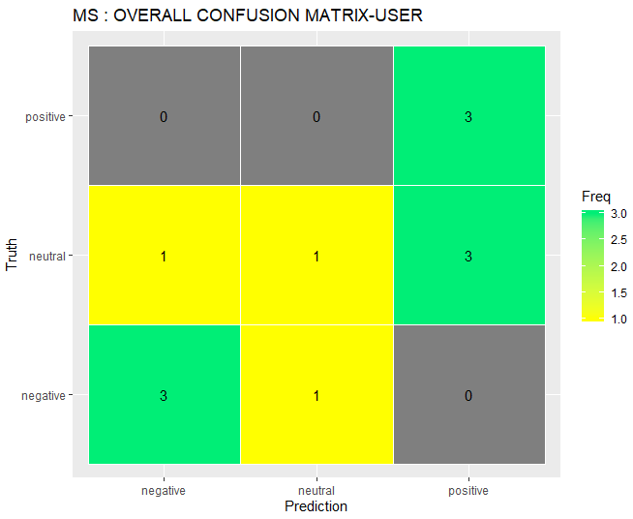
OVERALL CONVERSATION LEVEL EMOTION

Slide 10
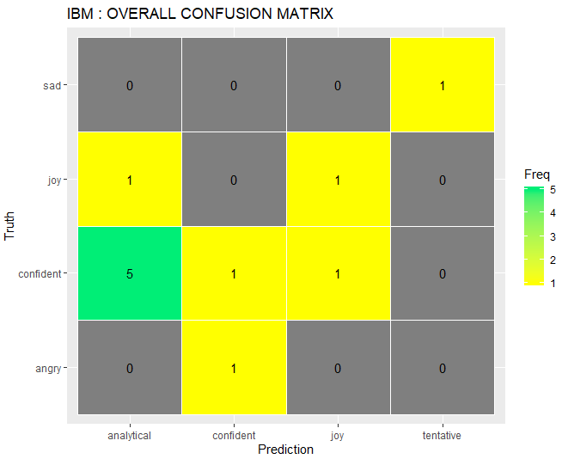
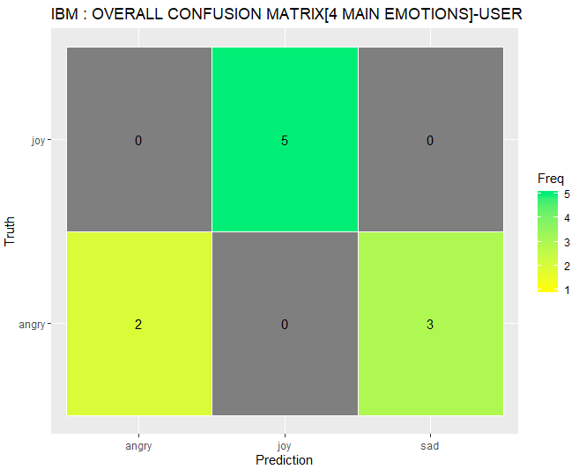
Filtered : CONFIDENT , ANALYTICAL , TENTATIVE
Only: Anger , Joy , Sad , Fear

Slide 11
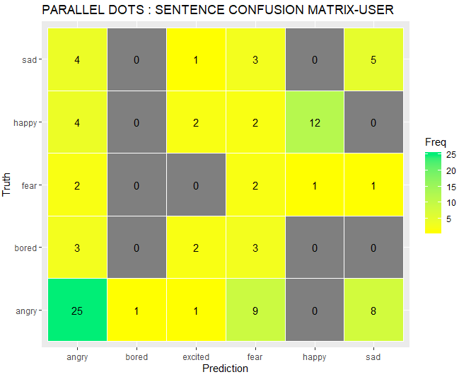
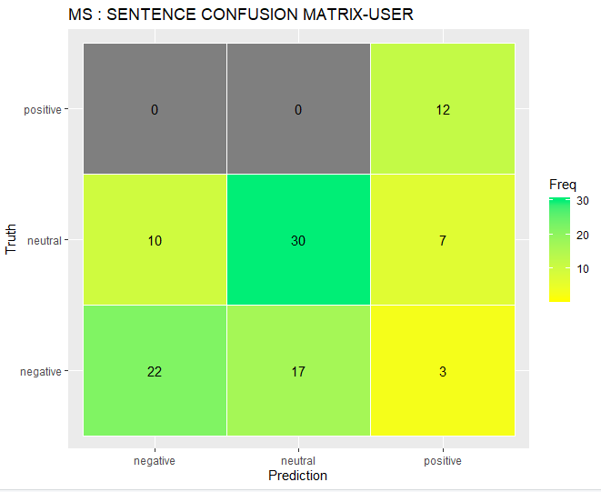
SENTENCE LEVEL EMOTION

Slide 12
BenchMark
API

Slide 13
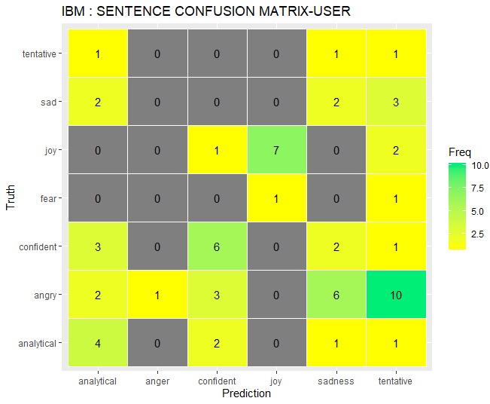
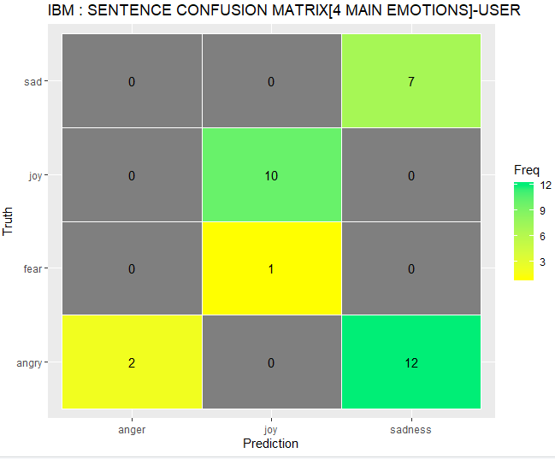
Filtered : CONFIDENT , ANALYTICAL , TENTATIVE
Only: Anger , Joy , Sad , Fear

Slide 14
Random Forest

Slide 15
BenchMark
API

Slide 16
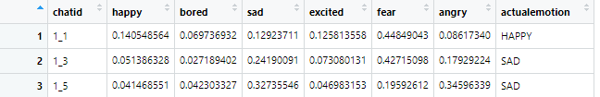
BenchMark
API

Slide 17
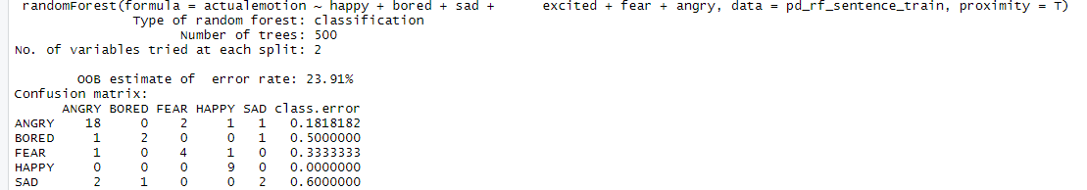
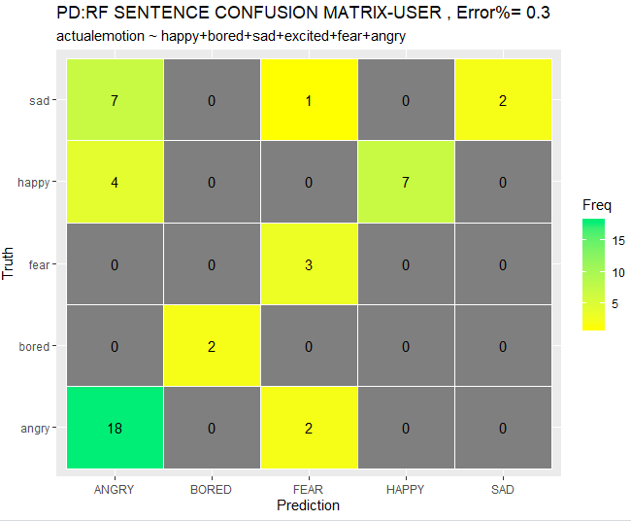
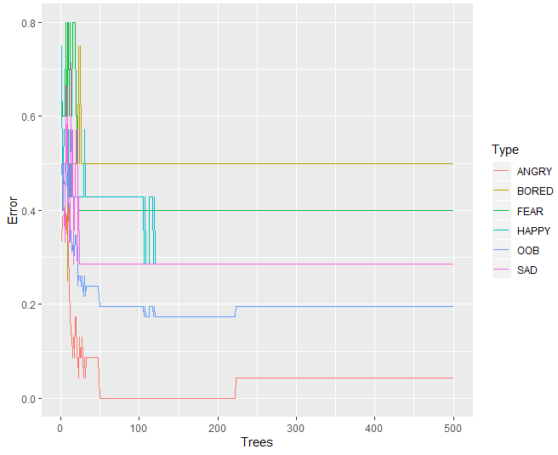
Parallel Dots

Slide 18
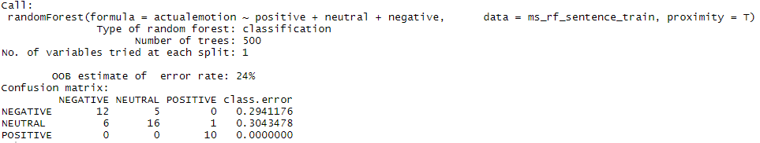
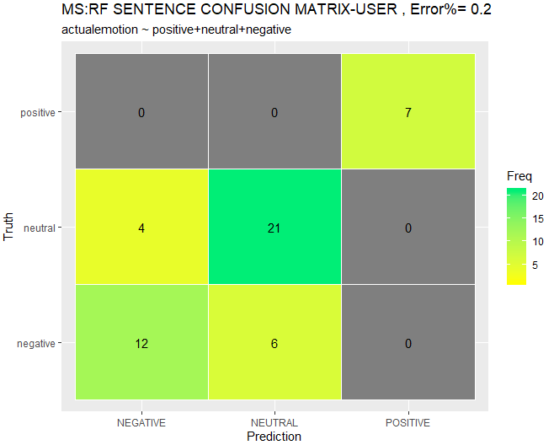
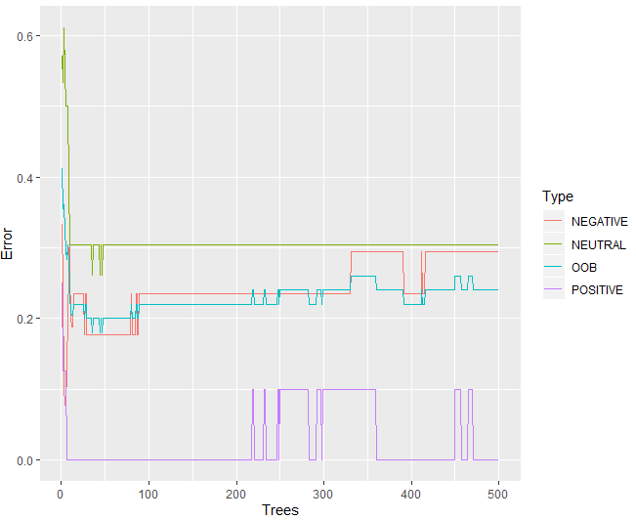
MS Analytics

Slide 19
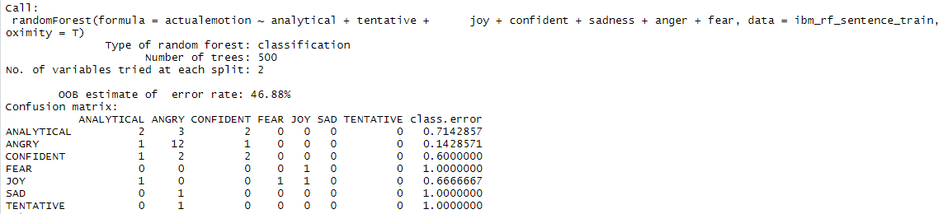
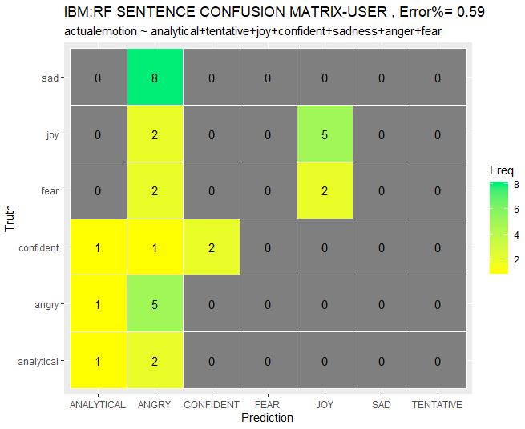
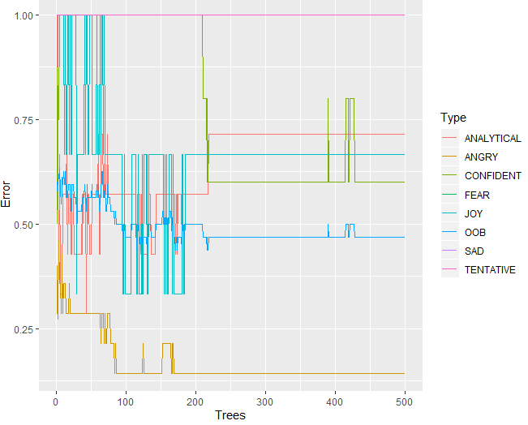
IBM Tone Analyzer

Slide 20
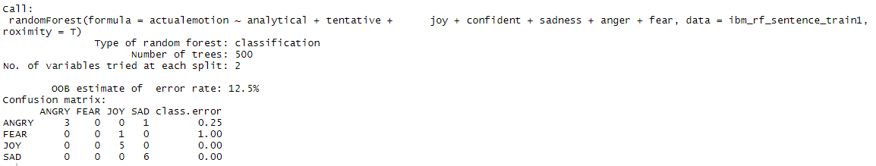
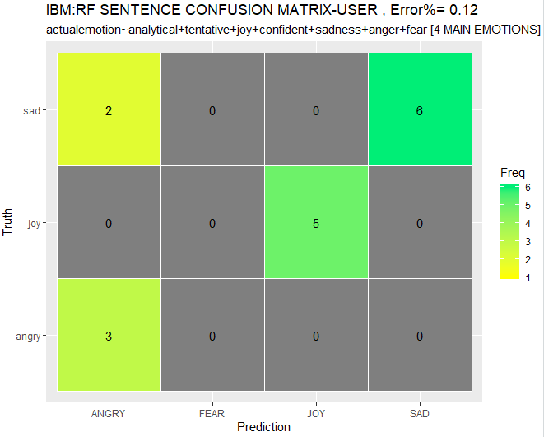
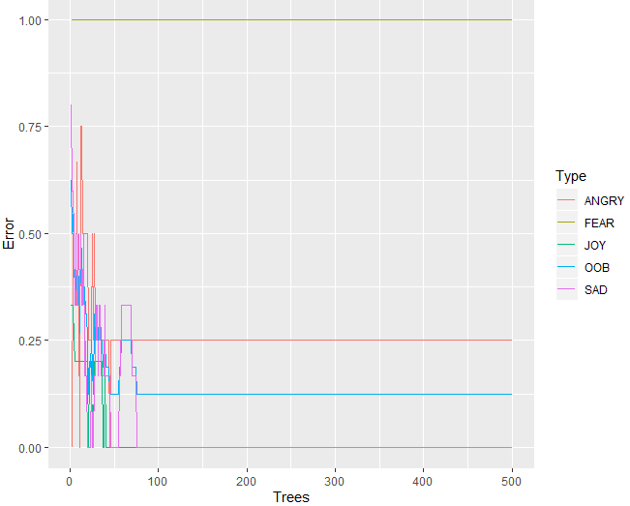
IBM Tone Analyzer
[Main Emotions]

Slide 21
Random Forest
[Custom Models]

Slide 22
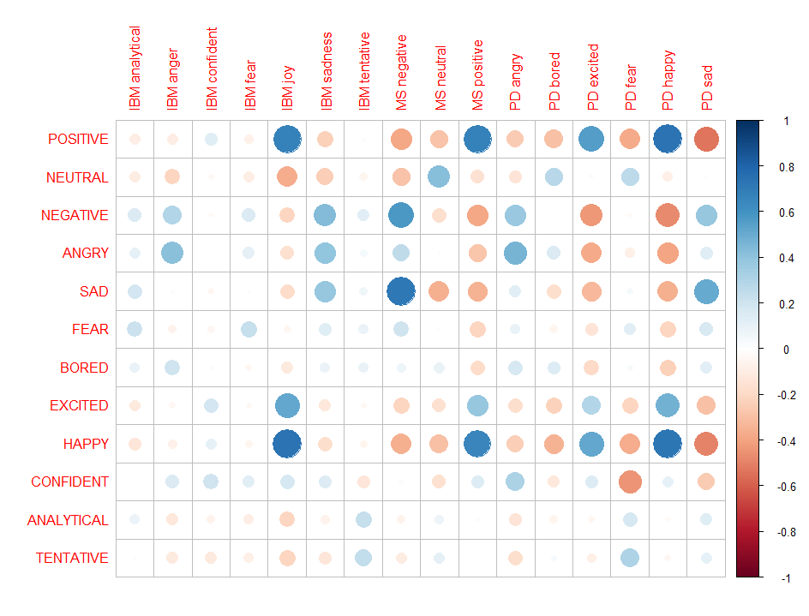

Slide 23
BenchMark
API

Slide 24
BenchMark
API

Slide 25
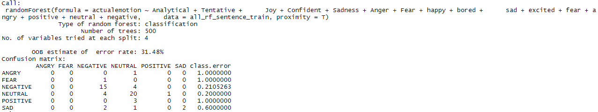
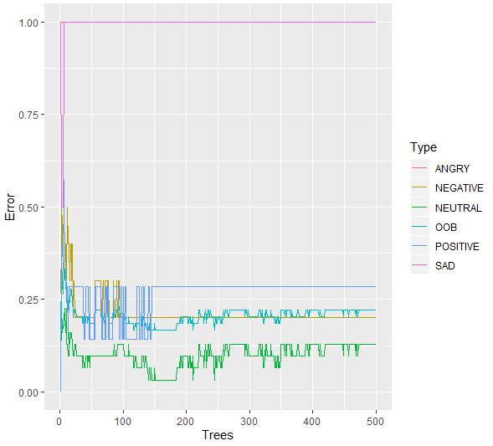
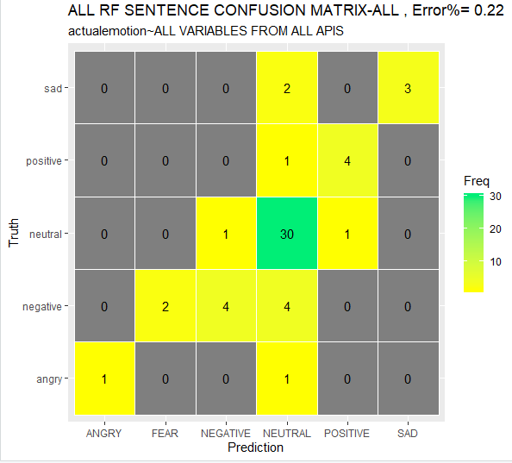
All API variables values Predicting Highest
Among All Scored Emotions

Slide 26
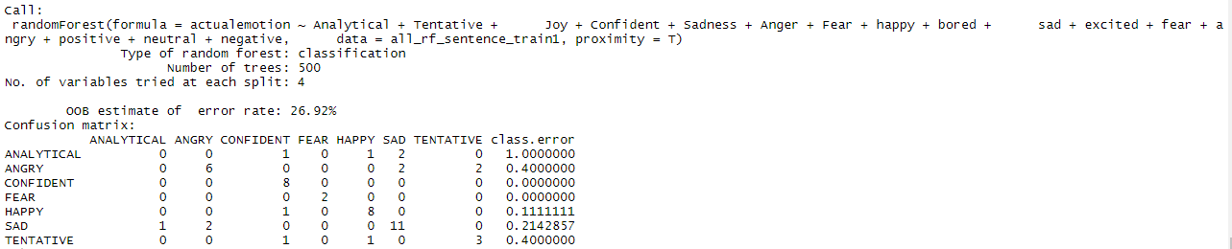
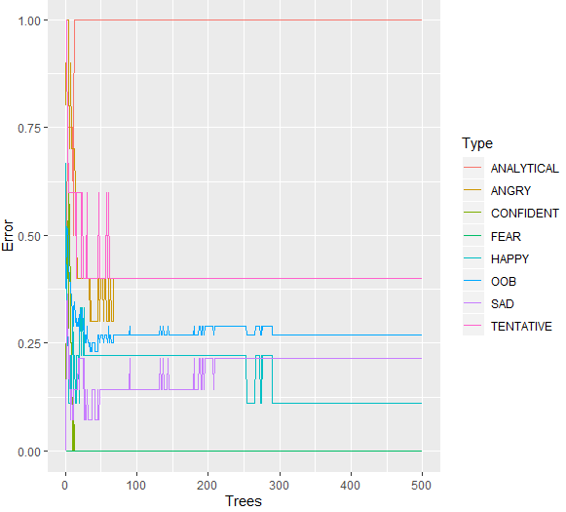
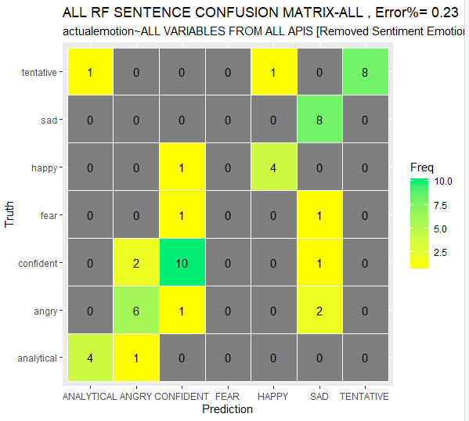
All API variables values Predicting Highest
Among All Scored Emotions Except
Sentiment (+ve,-ve,Neutral Scores)

Slide 27
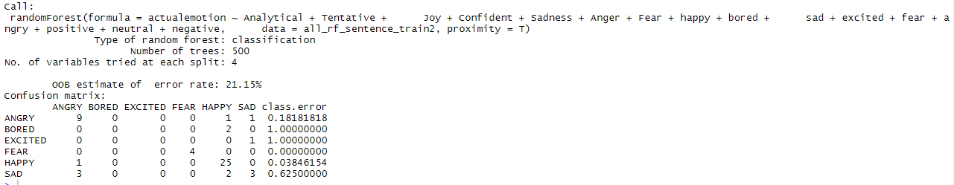
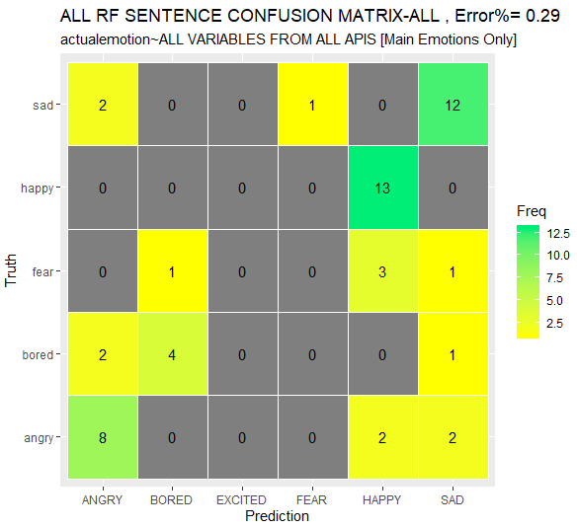
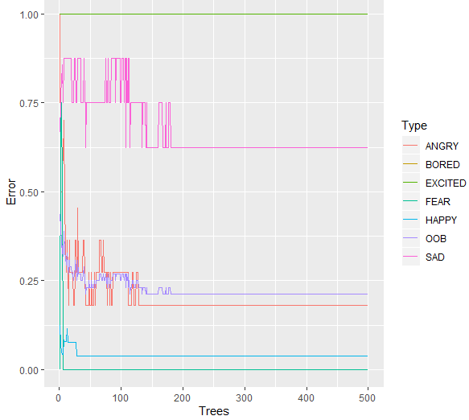
All API variables values Predicting Highest
Among Select Scored Emotions:
ANGRY,SAD,FEAR,BORED,EXCITED,HAPPY

Slide 28
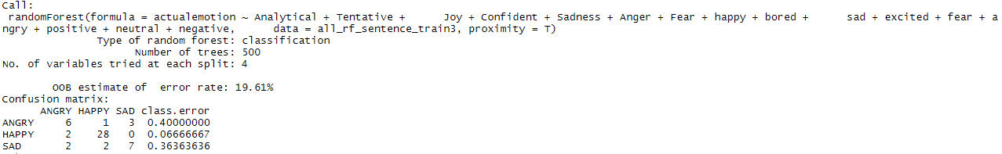
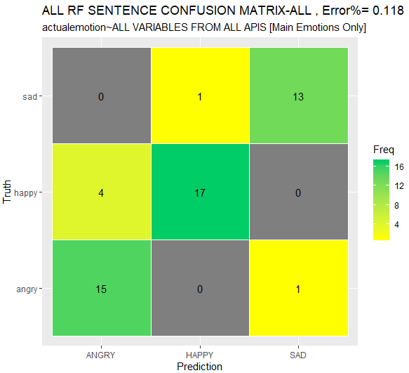
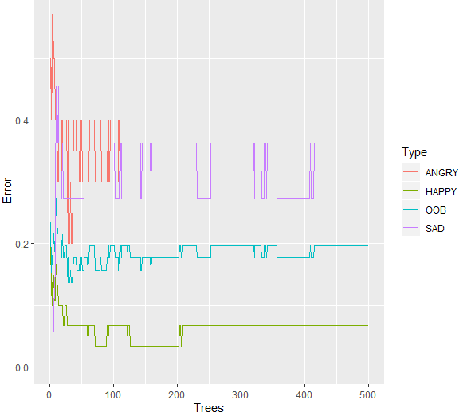
All API variables values Predicting Highest
Among Select Scored Emotions:
ANGRY,SAD,HAPPY

Slide 29
DISAPPOINTED
…
…
…
…

